Slide 1
Java Project

Slide 2




The Crew
Antonin Nowak
Database
Level Design
Ivan Chaban
Controller
Game Keynote
Valentin Pique
View
Project Manager
Romain Kauffmann
Model

Slide 3
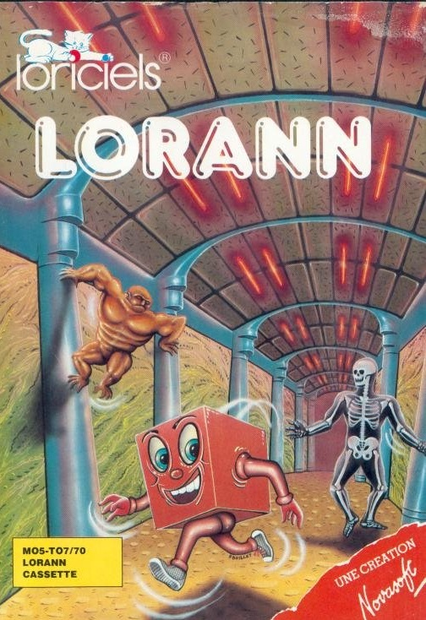
Lorann, the origins…
First released in 1985
Created by Novasoft and edited by Loriciels
For both Thomson MO5 and TO7/70 computers
Shipped as a tape recording
Only sold in France

Slide 4
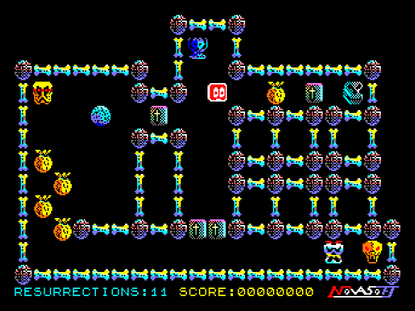
Game design
Tile-based levels
101 levels
30 slots for custom maps

Slide 5

Game design
Four collectable items to increase your score
Purses
Chandeliers
Oil lamps
Cups
Collecting the crystal ball opens the door

Slide 6

Game design
Four dangerous monsters protecting the caves
They will chase you until you die
You can avoid them or shot them with a magic spell

Slide 7








Used tools and software

Slide 8
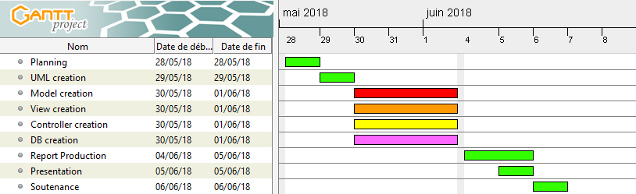
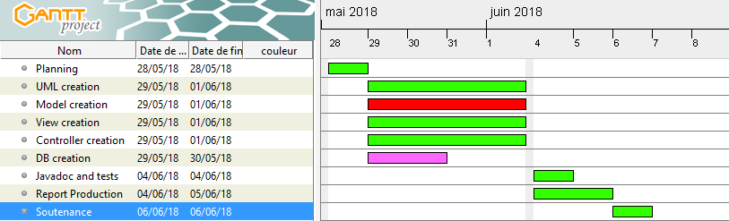
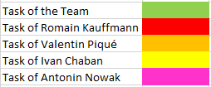
Schedule
Expected
Real
Notes:
Hello … ,

Slide 9
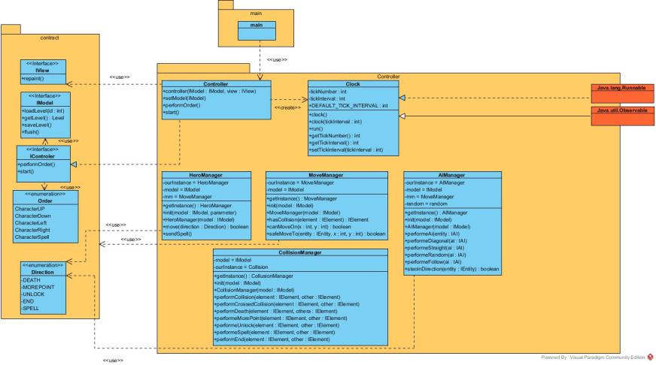

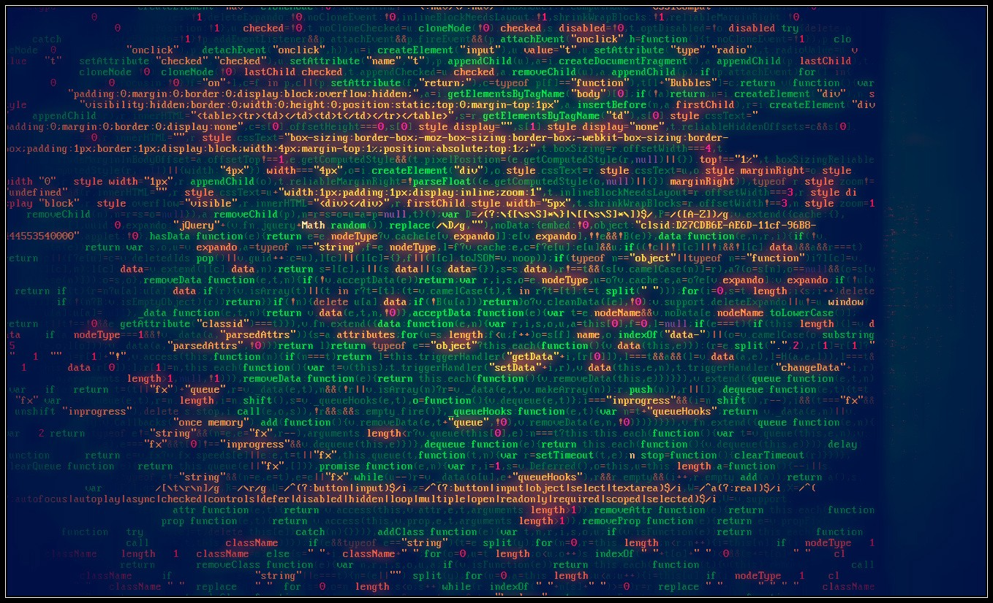
Our own version of the game…
Notes:
Hello … ,

Slide 10
Demo
Notes:
Hello … ,

Slide 11
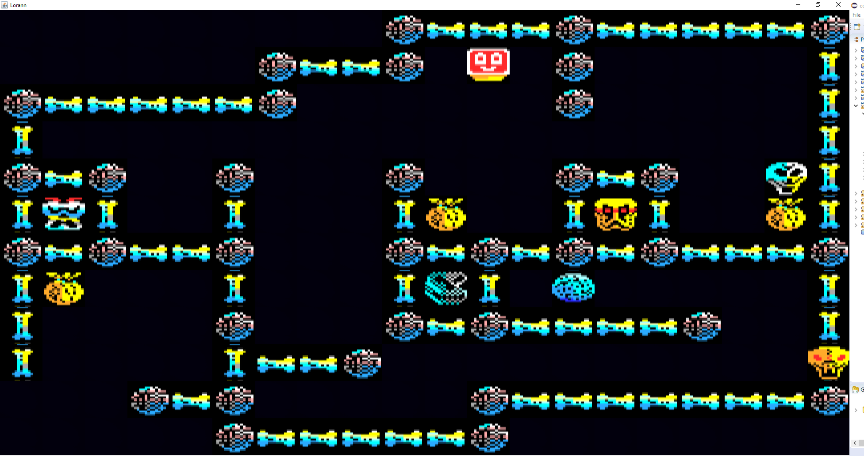
Our own version of the game…
Conclusion
Differences:
+ Both graphical and performance enhancement
- Lack of sounds, menus and levels
Notes:
Hello … ,

Slide 12
Thanks for your attention!
Questions?

